Slide 1
Product Knowledge Training Session PIBAS Products - Module: TELLER / CURR. DENOM. MANAGEMENT
Presented By PIBAS Support Team

Slide 2
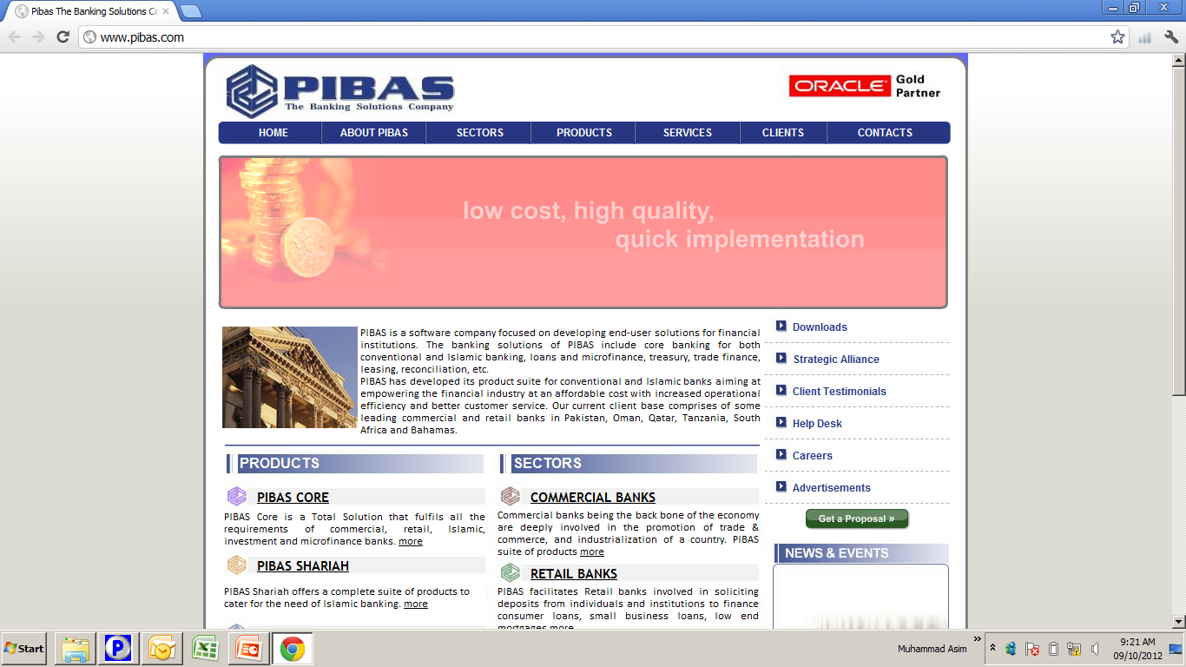
Contents
Teller Management
Cashier Addition
Notes Denomination Addition
Cashier Opening Balance Addition
Currency Denomination Transaction
Cashier Status Report
Cashier’s Transaction List
PIBAS Teller Summary

Slide 3
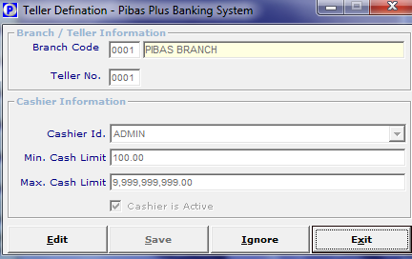
Teller Management
Cashier Addition
How To Process / Important Points To Be Noted Before This Option
This option provides facility wherein Teller No., User ID, Min. Limit, Max Limits and Cashier Is Active could be defined.

Slide 4
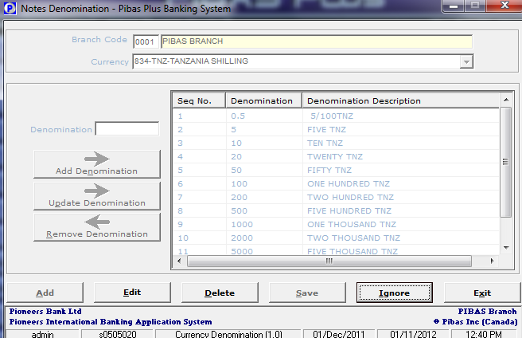
Teller Management
Notes Denomination Addition
How To Process / Important Points To Be Noted Before This Option
Here each and every denomination of a currency could be defined / deleted / amended.

Slide 5
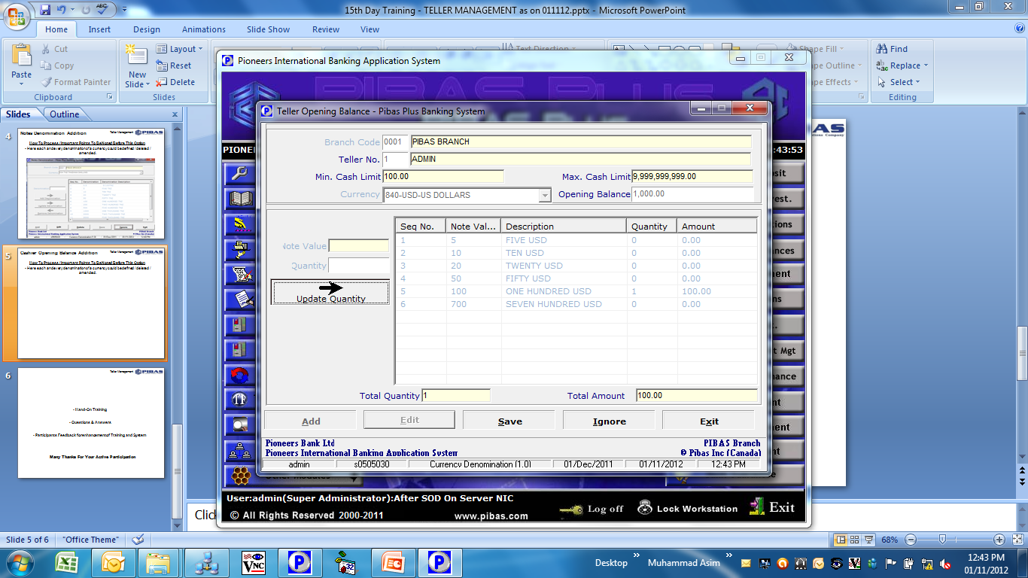
Teller Management
Cashier Opening Balance Addition
How To Process / Important Points To Be Noted Before This Option
Through this option a supervisor / head cashier or any authorized officer can open a cash draw of a cashier after physically handing over the cash.

Slide 6
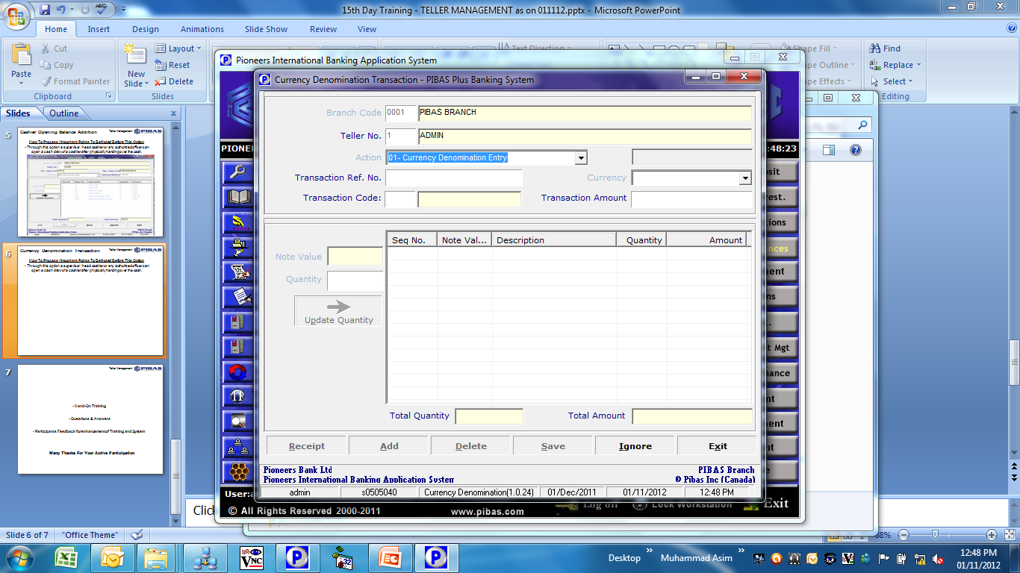
Teller Management
Currency Denomination Transaction
How To Process / Important Points To Be Noted Before This Option
In this option three types of currency denomination transactions could be done. 1. Currency Denomination Entry. 2. Exchange Transfer 3. Teller Transfer Transaction

Slide 7
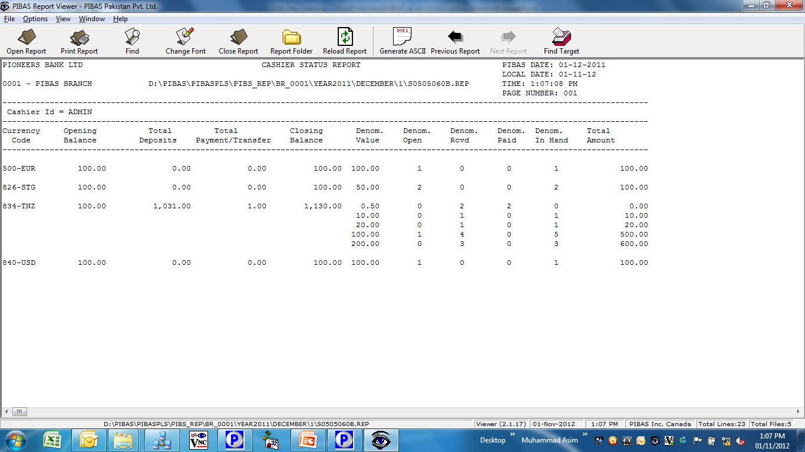
Teller Management
Cashier Status Report
How To Process / Important Points To Be Noted Before This Option
This is very useful report that shows the following information

Slide 8
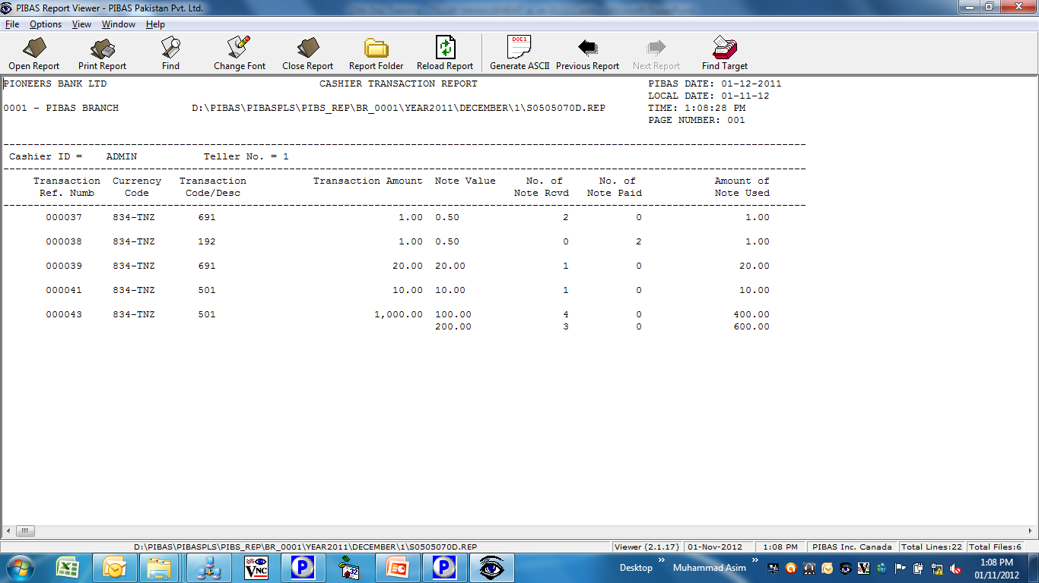
Teller Management
Cashier’s Transaction List
How To Process / Important Points To Be Noted Before This Option
This is very useful report that shows the following information

Slide 9
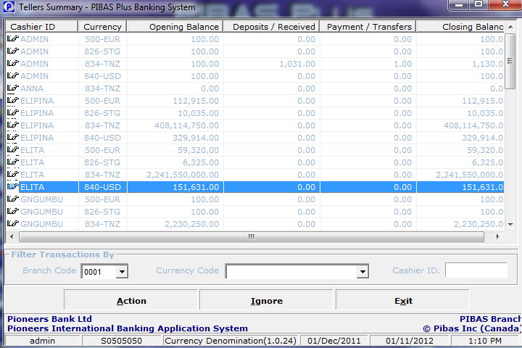
Teller Management
PIBAS Teller Summary
How To Process / Important Points To Be Noted Before This Option
This is very useful view screen option that provides summary of all cashiers transactions during a day

Slide 10
Teller Management
Hand-On Training
Questions & Answers
Participants Feedback for enhancement of Training and System
Many Thanks For Your Active Participation

